Slide 1
Major features
of the Milky Way
and the Universe

Slide 2
A constellation is
a group of stars
than appear to be together but
are not.
They seem to form a picture in the sky.
People use them to find their way around the sky like someone using objects to get from place to place.

Slide 3
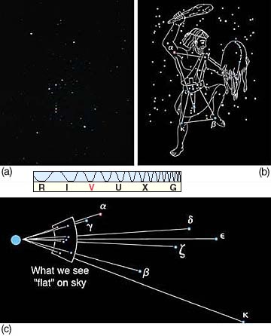
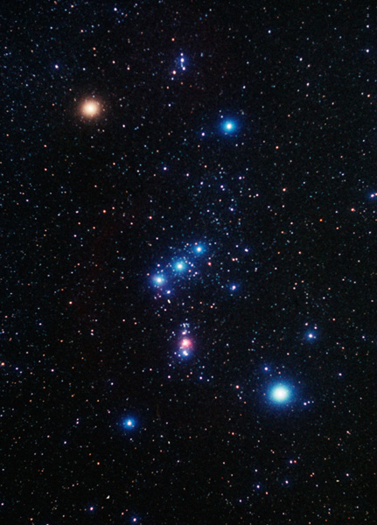
Orion the hunter
The constellation looks flat but all the stars are at different distances from us.

Slide 4
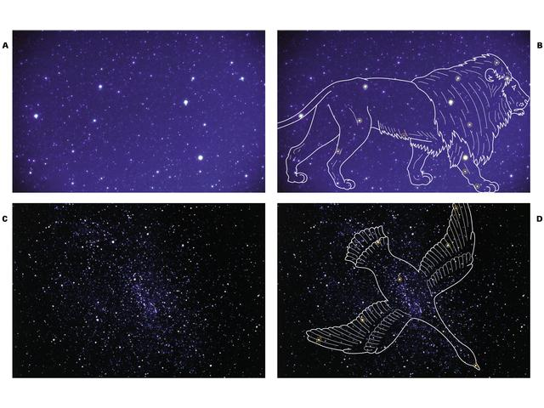
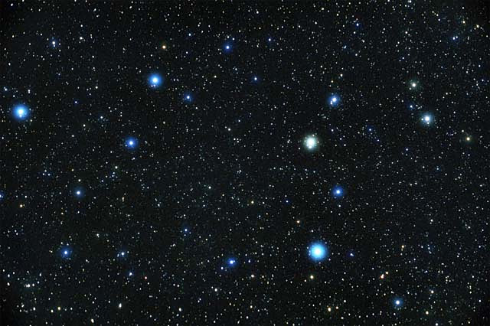
Leo the Lion
Can you see the drawing?
Cygnus the Swan

Slide 5
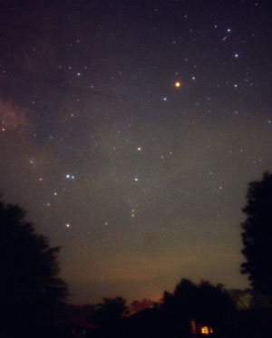
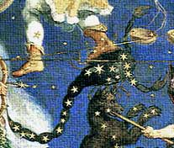
Scorpio

Slide 6
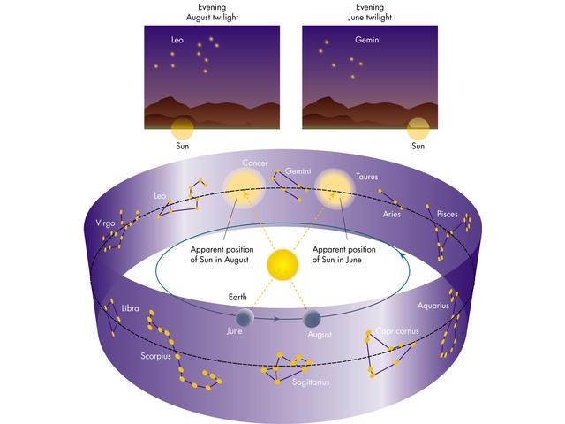
The Zodiac is a special group of constellations that extend out from Earth’s equator.

Slide 7
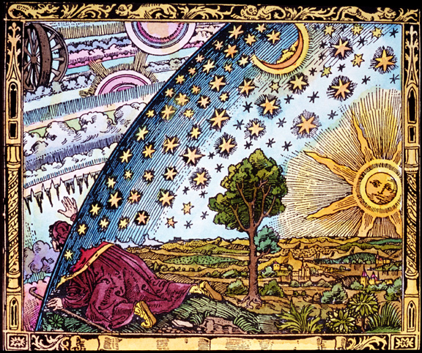
Astronomers want to
know how far
away stars are!
From here on earth, they all look the same distance. In fact, ancient people thought they were all “stuck” on a glass sphere.

Slide 8
To measure the distances in space, astronomers use a light year.
A light year is the DISTANCE light travels in one year. One light year is equal to a little under 6 trillion miles! (6,000,000,000,000)
Proxima Centauri is the closest star to our solar system. It is about 4 light years away. Going the speed of light it would take us 4 years to get there.
Traveling as fast as the average spaceship, it would take between 70,000 and 100,000 years to get there!
Video clip on a light year

Slide 9
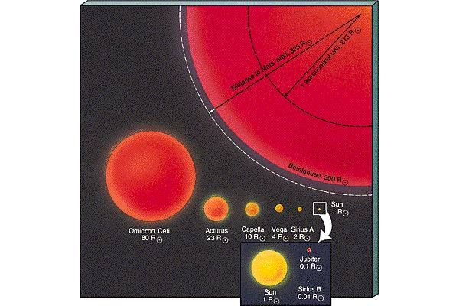
Supergiant
Giant
Medium sized
White dwarf
Neutron star
Star sizes

Slide 10
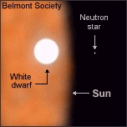
Comparison of our sun with a white dwarf and a neutron star.

Slide 11
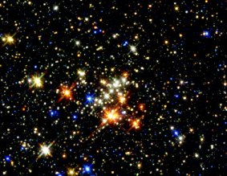
Star color
Determined by surface temperature.
Hottest are blue – coolest are red.
Video clip on star colors

Slide 12
Absolute and
apparent magnitude
Apparent magnitude is how bright a star appears to be due to how close or far away it is.
Absolute magnitude is how much light is actually given off by a star.

Slide 13
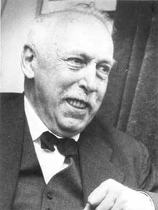
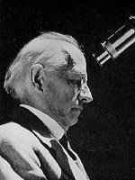
Two astronomers discovered a relationship between the absolute magnitude (real brightness) of a star and its surface temperature. They plotted the data on a graph.
Ejnar Hertzsprung
Denmark
Henry Russell
USA

Slide 14
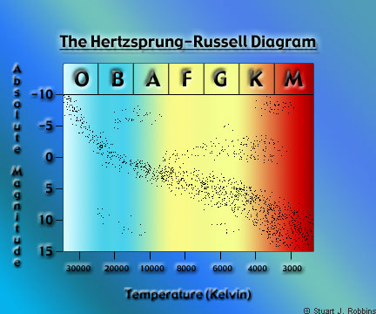
So what does this show?
Stars seemed to naturally group together

Slide 15
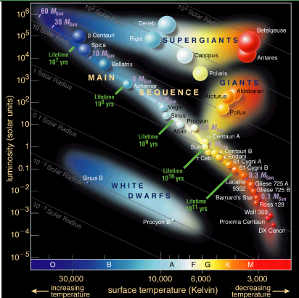
They discovered that stars grouped by type and during their lifetimes would move from one place on the graph to another. As our sun ages, it will move to a giant star to a white dwarf.

Slide 16
Life cycle of a star
When a star forms it begins its “life.”
When a star runs out of fuel, it dies.
So a star has a life similar to a battery that cannot be recharged. When the battery runs out of energy, it is finished. Our sun will run out of energy and it will be finished too. But this will not happen for another 5 billion years!
Video clip of life cycle of stars

Slide 17
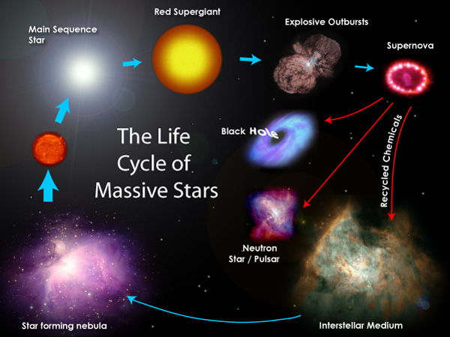

Slide 18
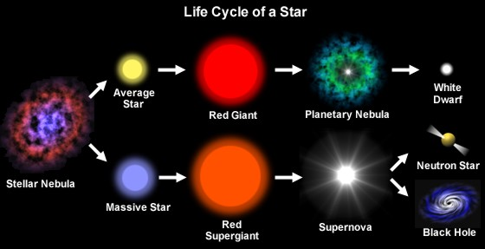
This diagram follows the life of both large and average stars.
Video clip about neutron stars and black holes.

Slide 19
Life cycle of our sun
We are now here

Slide 20
A galaxy is a large
group of stars
bound together
by gravity.

Slide 21
There are three
kinds of galaxies.
Spiral
Irregular
Elliptical
Video clip on galaxies

Slide 22
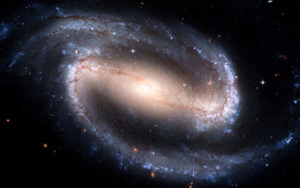
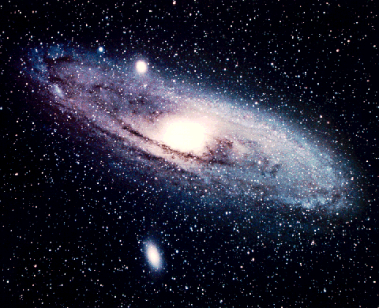
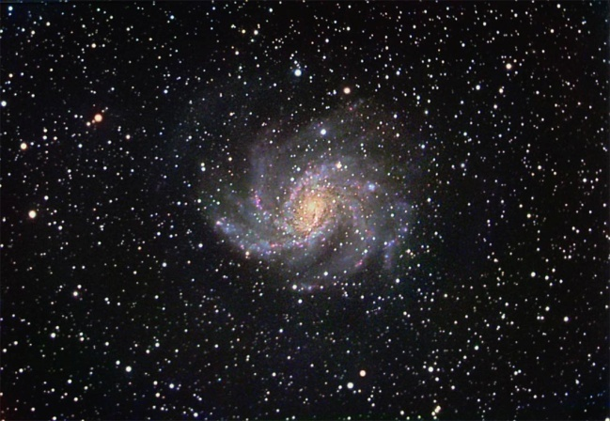
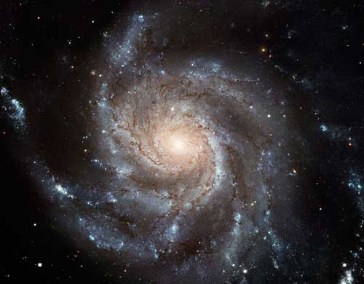
Some spiral galaxies
Pictures by the Hubble Space Telescope

Slide 23
Notice the individual stars in the picture. They are not part of the galaxy in the picture but part of our own Milky Way Galaxy.

Slide 24
So why are they in the pictures?
If you look out a window with wood trim, it is hard to get a view without them in the way. These stars are in our view as we are looking out of our galaxy!

Slide 25
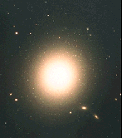
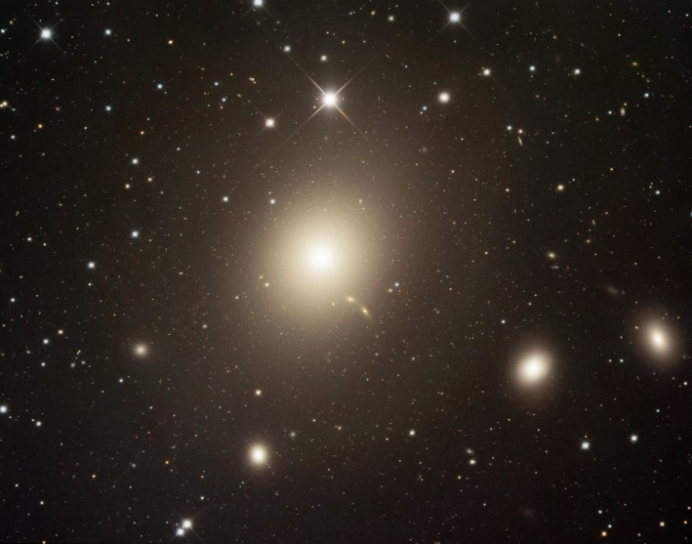
Elliptical galaxies

Slide 26
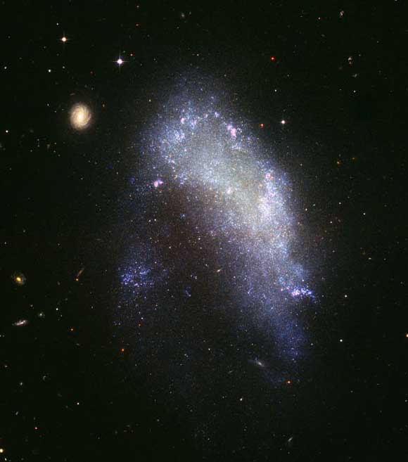
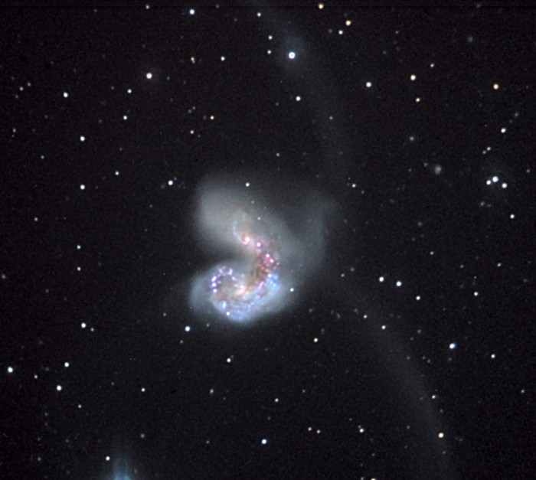
Irregular galaxies
no specific shape.

Slide 27
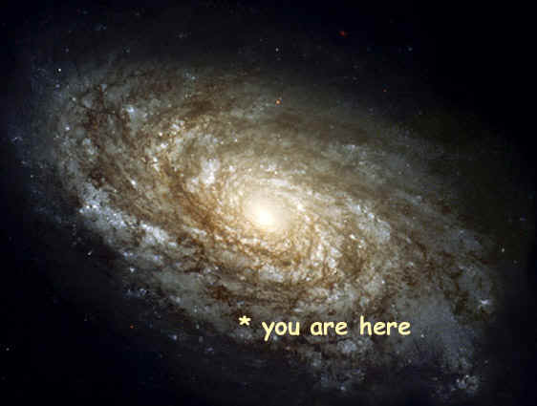
Our Milky Way Galaxy
is a spiral galaxy.
We think!
This is not really a picture of our galaxy – just one that looks like what we think our galaxy is like!

Slide 28
Why not?
If you were inside Lanier Middle and had never been out of the building your entire life, would you be able to know what the school looked like from a distance?
Of course not. All you could do is look out the windows and get some view of part of the building. If you looked out enough windows you might get a general idea but you could never know for sure if you were right about all its features.

Slide 29
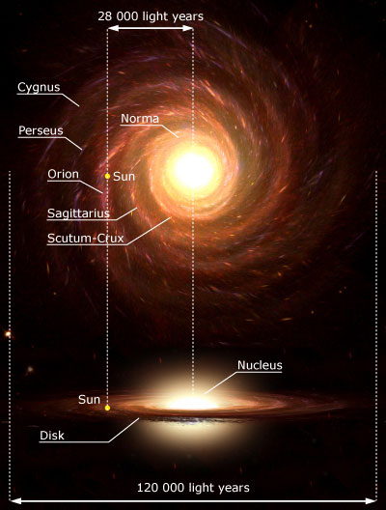
Top view
Side view
Video clip on our location in the galaxy

Slide 30
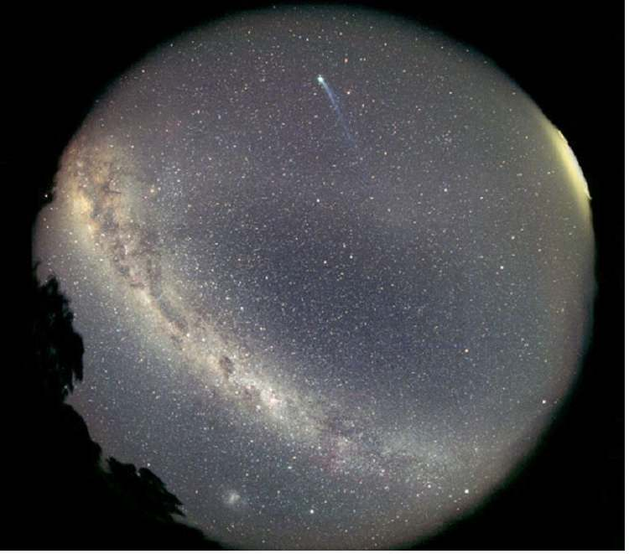
Notice the comet
Our view of the Milky Way
In the night sky, a band of stars can be seen across the sky as a blurry image. When you see this, you are looking into the part of the galaxy with more stars.
Milky Way using a “fish eye” lens

Slide 31
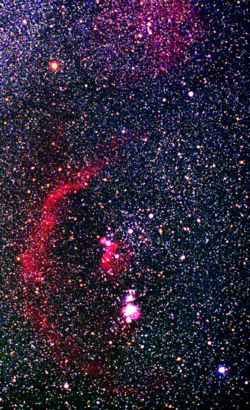
Every star we see in the night sky is in our own galaxy. We cannot see stars in other galaxies because they are too far away.
The Milky Way is estimated to have
200 billion stars.

Slide 32
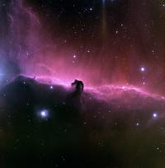
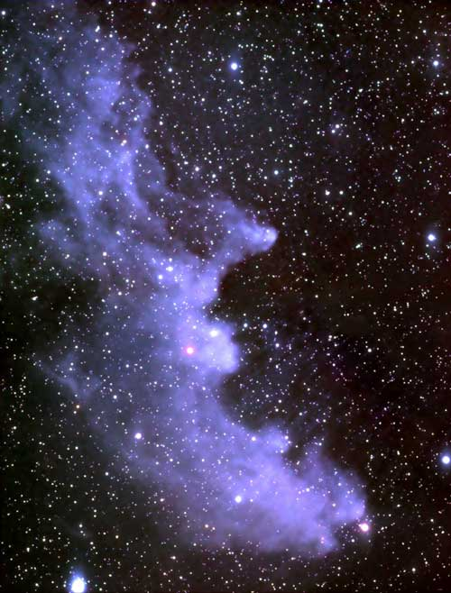
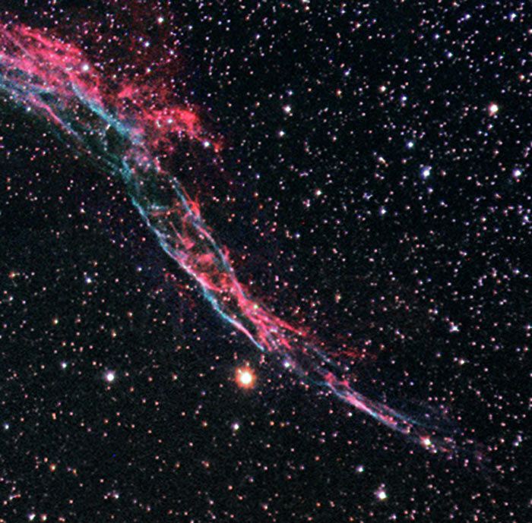
Witch head
nebula
Horse head nebula
Nebulas are often named
by what they look like!
They provide the material for new stars to form.
Veil nebula

Slide 33
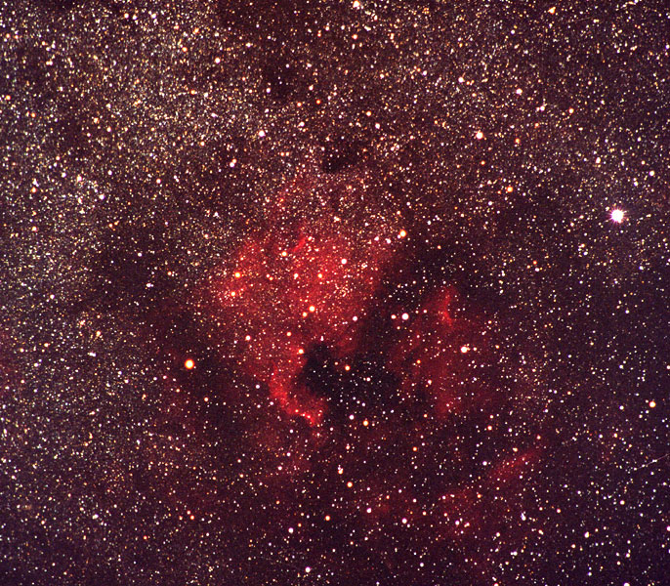
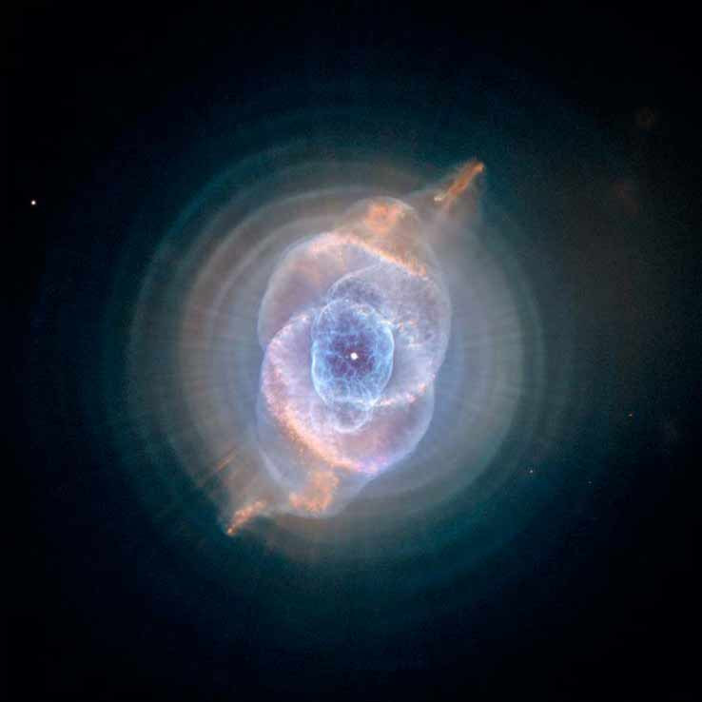
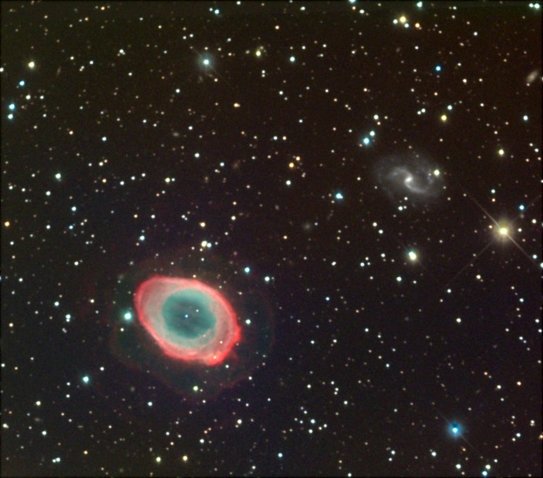
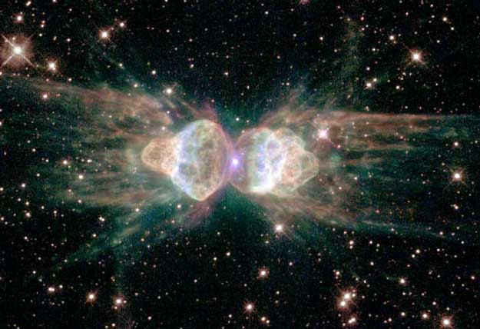
North American nebula
Cat’s eye nebula
ring nebula
ant nebula

Slide 34
Current estimate of the age of the universe is 13.7 billion years.
The solar system is 4.6 billion years old.
The solar system is not the same age as the entire universe.

Slide 35
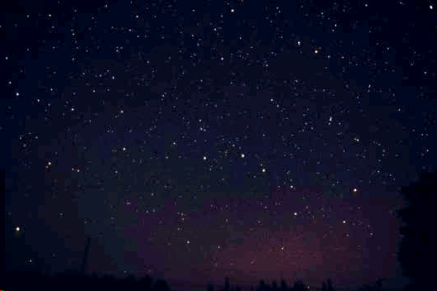
Hubble deep field
Click on the picture and watch as the Hubble telescope zooms in to an area just above the Big Dipper!

