Slide 1
What is environmental science?
The study of the physical and biological factors along with their chemical reactions that affect organisms.

Slide 2
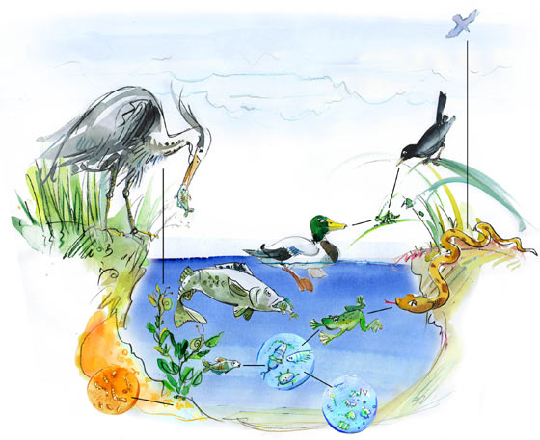
The Environment

Slide 3
New Terms
Environment
Ecosystem
Community
Population
Species
Organism
Habitat
Ecology
Biotic Factors
Abiotic Factors
Limiting Factors
Producer
Consumer
Food Chain
Food Web
Energy Pyramid

Slide 4
Levels of Organization

Slide 5
Populations and
Interactions/Relationships

Slide 6
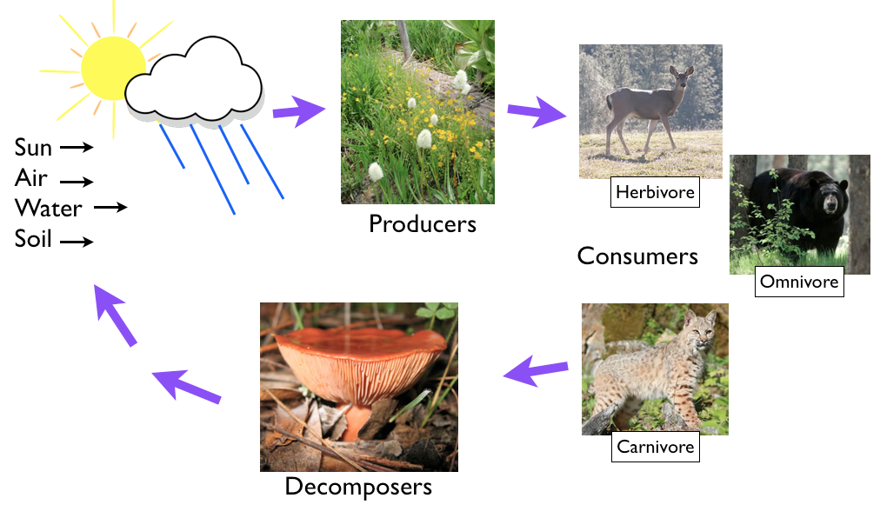
Food Chains/Food Webs

Slide 7
Environmental Cycles

Slide 8
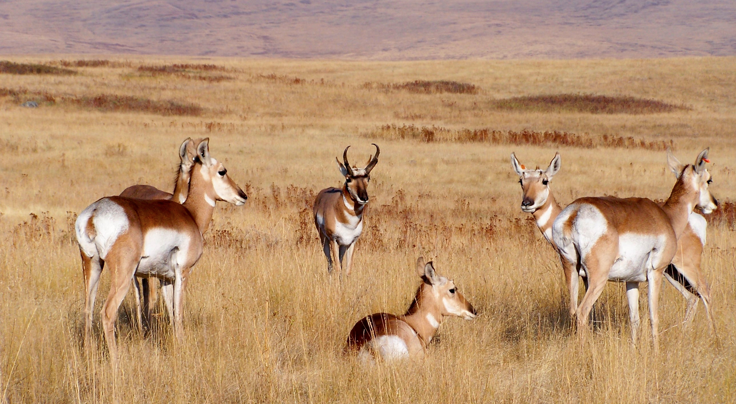
Pronghorn

