Slide 1
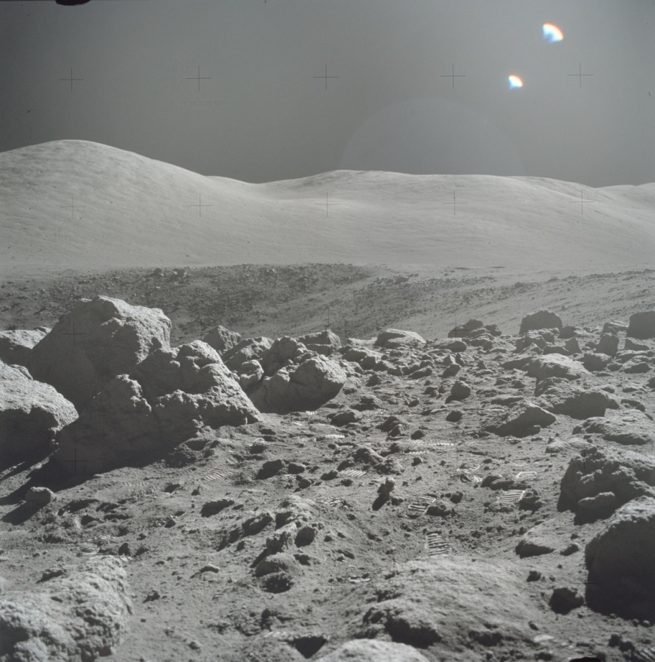
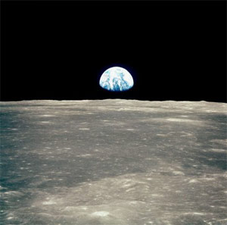
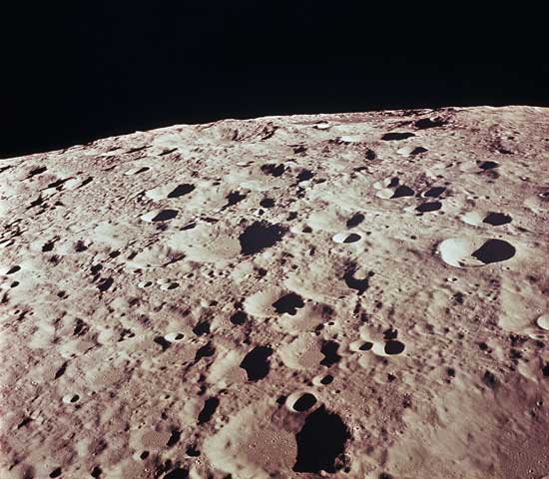
How did the Moon get here?

Slide 2
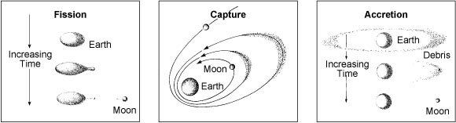
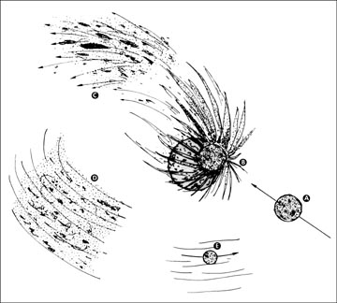
Hypotheses of the origin of the Moon
giant Impact

Slide 3
Origin of the Moon: Which hypothesis is correct?
Hypothesis | Volatiles | Isotopes | Orbit | Iron | Physics
Giant Impact | A | A | B+ | A | B+
Fission | B | B | F | A | F
Capture | F | F | A | C | F
Co-accretion | F | A | F | F | B
A = v. good match; C = matches some data; F = doesn’t match

Slide 4
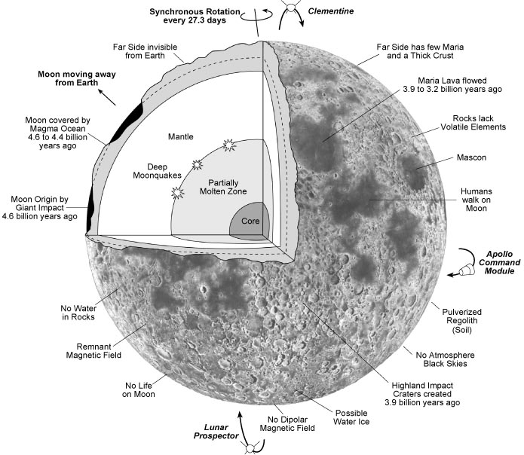

Slide 5
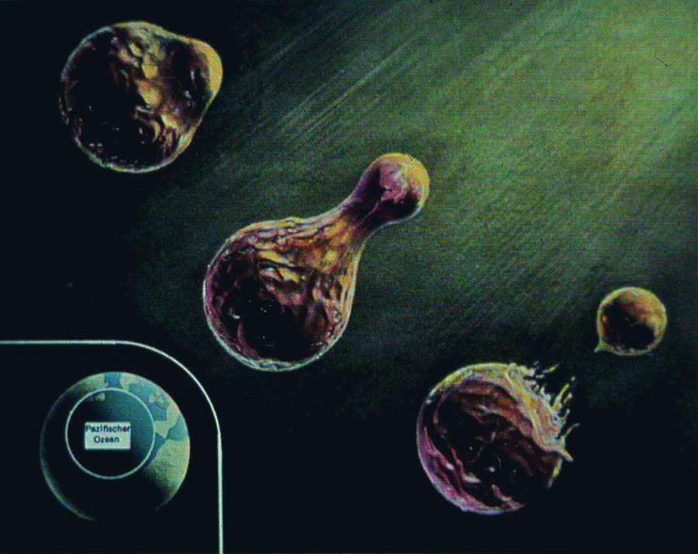
Fission origin of the Moon, out of the Pacific Ocean (George Darwin)

Slide 6
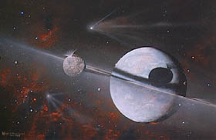
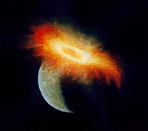
Giant impact hypothesis
A projectile about the size of Mars, struck the young, Earth in a catastrophic, glancing blow nearly 4.6 billion years ago.
Material was jettisoned outward, and some fraction of this mass remained in Earth orbit and formed the Moon.
The Moon may be mostly derived from the crust and mantle of the Earth and/or the impacting object.
The giant impact and quick accumulation of material resulted in a hot, molten Moon, which accounts for the relative lack of water and other volatile elements.
After the crust cooled, impacts into the Moon scarred the surface with numerous craters.

Slide 7
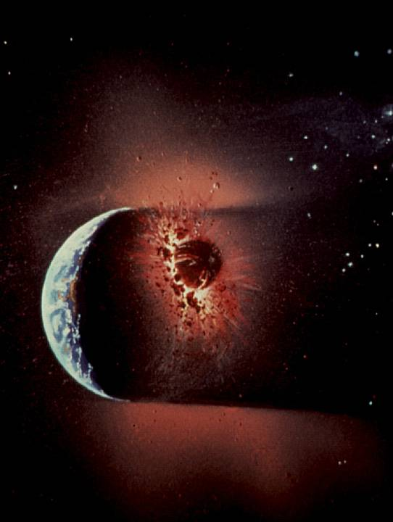
Artist’s conception of the Giant Impact Hypothesis of the Moon

Slide 9
CRAY supercomputer simulation of the origin of the Moon by a collision of Earth with a Mars-sized projectile.
Note: The Moon formed mostly from the silicate portions of the projectile and Earth’s mantle, whereas the metal core of the impactor merged with Earth’s metallic core. Hence, the Moon is depleted in metal and has a lower density than earth.

Slide 10
So what has happened since the moon formed?

Slide 11
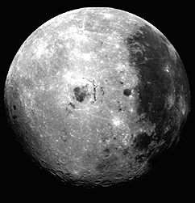
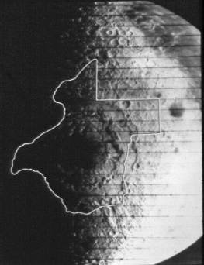
Gigantic impacts during the early history of the Moon caused formation of Multi Ring Basins

Slide 12
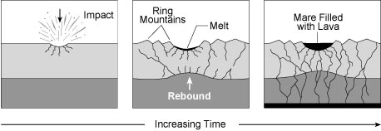
Volcanic Features: Lava flows infill mare
Impacts of comets and asteroids form huge basins
  4.3-3.85 billion years ago
Shock waves create fractures in the rock beneath the basin
Mountain ranges form as a result of the blast
Interior heat from radioactivity caused partial melting
Magma rose along the fractures, filling the basin
  3.9 and 3.1 billion years ago and younger

Slide 13
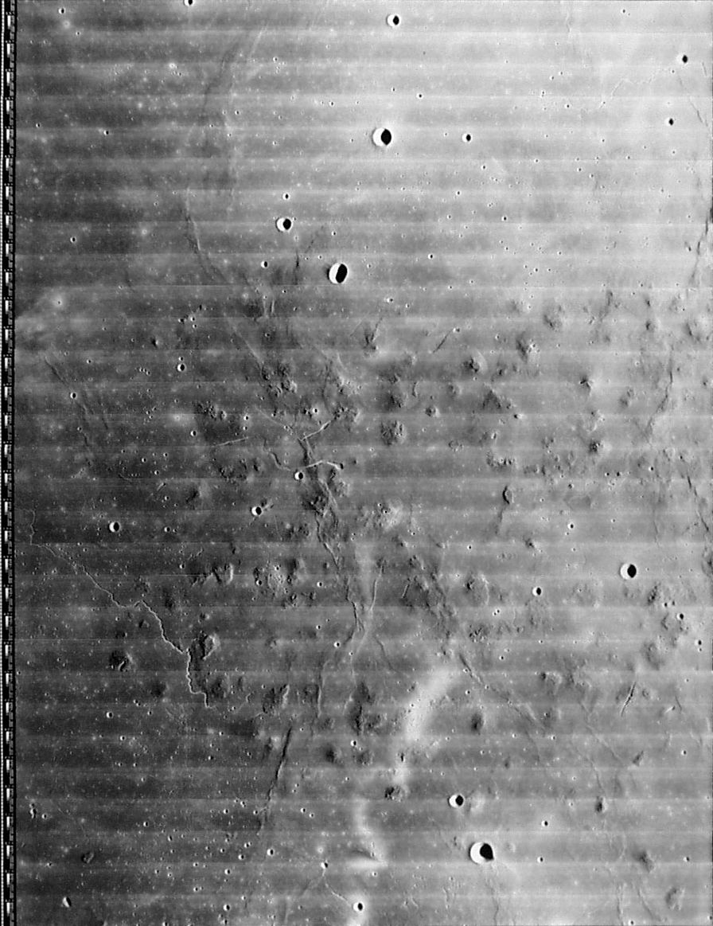
Lunar volcanoes
Lava channels
Domical hills

